Slide 1


REAL TIME SYSTEM FOR SIGN LANGUAGE RECOGNITION
Presented by
SANDEEP SV
U01CJ23S0037
ROSHAN LOUIS MENEZES
U01CJ23S0010
MUHAMMED ADNAN
U01CJ23S0003
JALAM SINGH CHOUHAN
U01CJ23S0024

Slide 2
INDEX
Introduction
Problem Statement
Objectives
Scope of the project
Literature review
Software requirements
Methodology
System Architecture
Dataset Description
Results
Applications
Conclusion

Slide 3
INTRODUCTION
Sign language is a visual language that uses hand gestures, facial expressions, and body movements for communication.
Used mainly by hearing and speech-impaired people.
Different countries have different sign languages.
Example: American Sign Language (ASL), Indian Sign Language (ISL).
Technology can help translate gestures into text or speech.

Slide 4
PROBLEM STATEMENT
Deaf people face difficulty communicating with others.
Most systems depend on speech or written language.
Few affordable systems exist for sign language translation.
Our system aims to recognize gestures and convert them into text in real time.

Slide 5
OBJECTIVES
Study basic sign language gestures.
Understand computer vision techniques.
Build a sign language recognition system.
Convert hand gestures into readable text.
Use machine learning for gesture classification.

Slide 6
SCOPE OF THE PROJECT
Recognizes only a predefined set of gestures.
Designed mainly for educational purposes.
Provides basic communication support.
Can be expanded to support more gestures and languages.

Slide 7
LITERATURE REVIEW
Researchers use machine learning and computer vision for gesture recognition.
Many systems use CNN (Convolutional Neural Networks) for detecting gestures.
Vision-based systems use cameras and image processing.
AI techniques improve accuracy and performance in gesture recognition.

Slide 8
SOFTWARE REQUIREMENTS
Python – Main programming language used to develop the project.
OpenCV – Used for image processing and webcam capture.
MediaPipe – Detects hand landmarks and tracks hand movements.
NumPy – Used for numerical calculations and data processing.
Windows OS – Operating system used to run the project.

Slide 9
METHODOLOGY
Gesture Capture: Hand gestures are captured using a webcam.
Preprocessing: Images are processed to improve quality and remove noise.
Feature Extraction: MediaPipe extracts 21 hand landmark points.
Model Training: Extracted features are used to train a neural network model.
Text Output: Recognized gesture is converted into readable text.
Waterfall Model: Used because project requirements were clear and development follows sequential stages.

Slide 10
SYSTEM ARCHITECTURE
CAMERA → MEDIAPIPE → LANDMARK EXTRACTION → NEURAL NETWORK → TEXT OUTPUT
Camera Input – Captures hand gesture using webcam
Hand Detection – MediaPipe detects hand
Landmark Extraction – 21 hand points are detected
Feature Processing – Data is normalized
Gesture Classification – Neural network predicts gesture
Output Module – Shows gesture as text

Slide 11
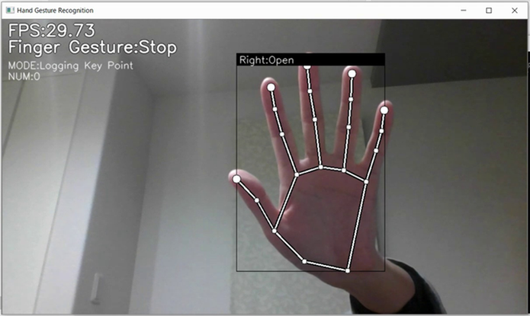
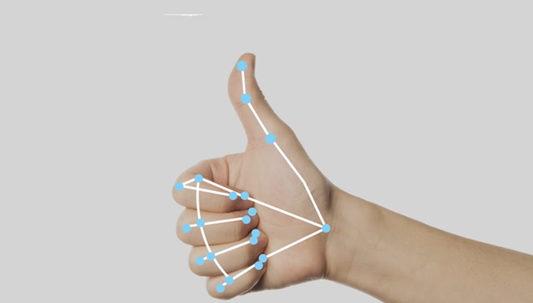
DATASET DESCRIPTION
Dataset contains images of different hand gestures.
Gesture samples are collected using a webcam.
Public datasets like ASL Alphabet Dataset are also used.
Each gesture has multiple samples for better accuracy.
Dataset includes gestures such as:
Hello
Thank You
Yes
No
Please

Slide 12
RESULTS
System Accuracy under Different Lighting Conditions
Good lighting – 95% accuracy
Medium lighting – 88% accuracy
Poor lighting – 75% accuracy
The system successfully recognizes basic gestures and converts them into text.

Slide 13
APPLICATIONS
Communication support for deaf people
Educational tools for learning sign language
Assistive technology for accessibility
Human–computer interaction systems

Slide 14
CONCLUSION
Sign language recognition helps reduce communication barriers.
AI and computer vision make gesture detection possible.
The system successfully converts gestures into text.
The project demonstrates a practical assistive technology
The system can be further improved with more gestures and voice output.

Slide 15
THANK YOU

